Slide 1
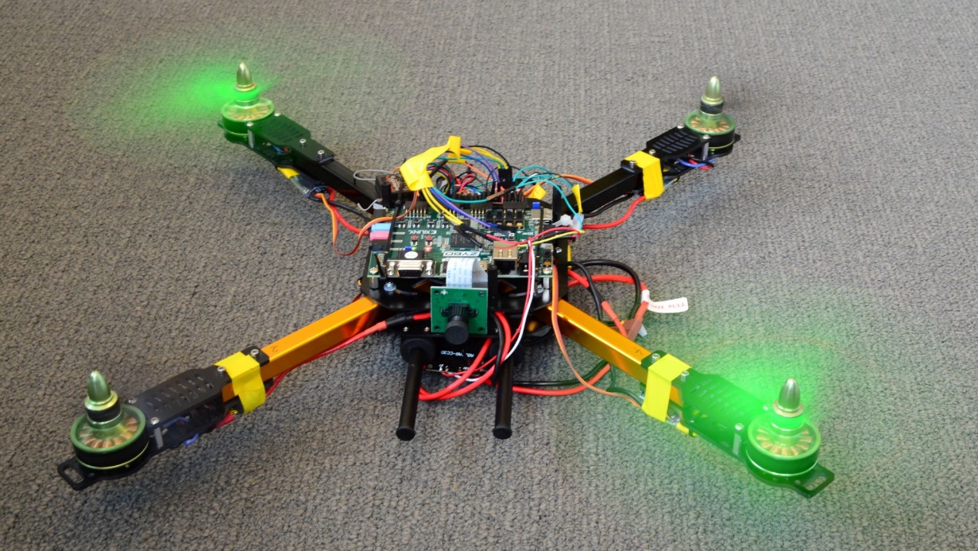
H01q6 Probleem oplossen en ontwerpen EAGLE Ready for part2!!!
W. Dehaene, P. Wambacq, M. Verhelst, R.Vanlaer

Slide 2
Overview
Planning 2nd semester
Room allocations
PC useage and ssh
Safety

Slide 3
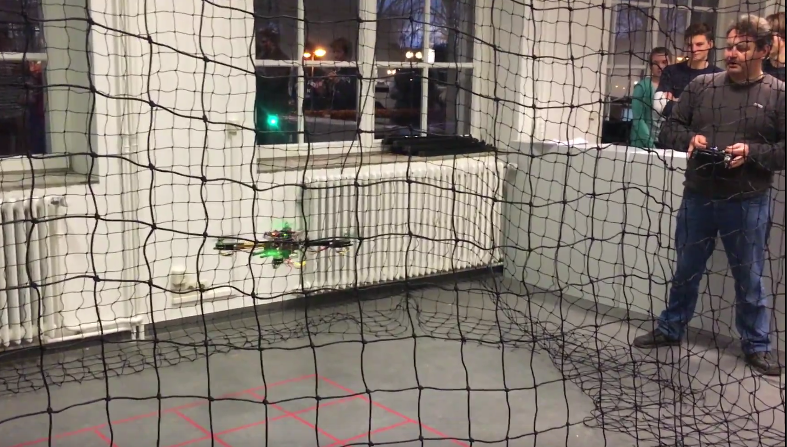
Eagle Part 2!
Succesful 1st semester!
Detected lines
Communicated videos
Spinned rotors
Transferred power
Even flew some drones!
Up to part 2!

Slide 4
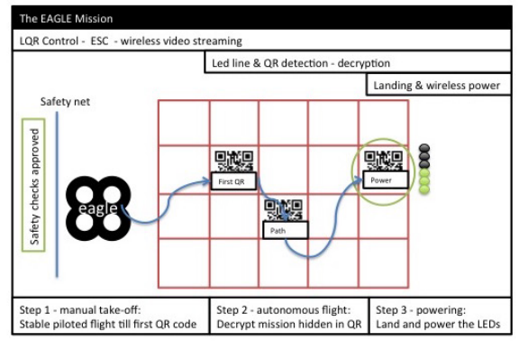
Integration integration integration

Slide 5


Phase 3 – Module phase
Target
Module design and implementation
Esp Crypto, nav. cntr., ESC & WPT (PCB solering)
Module test
Deliverable
Working modules, demonstrated
Pay attention:
T4 moved to 14.03!
Laptops in entrance hall…
Submit plan
Demo&poster
Demo&poster
Demo&present
PLAN PHASE
MODEL PHASE
MODULE PHASE
INTEGRATION PHASE
T0 T1 T2 T3 T4 T5 T6

Slide 6
Phase 4 – Integration phase
Target
Integrate all modules into a working drone
In a gradual, structured way!
Deliverables
An autonomous drone!
Submit plan
Demo&poster
Demo&poster
Demo&present
PLAN PHASE
MODEL PHASE
MODULE PHASE
INTEGRATION PHASE
T0 T1 T2 T3 T4 T5 T6

Slide 7

Phase 5 ?
The traditional
ESAT
Reception!

Slide 8
Overview
Planning 2nd semester
Room allocations
PC useage and ssh
Safety

Slide 9
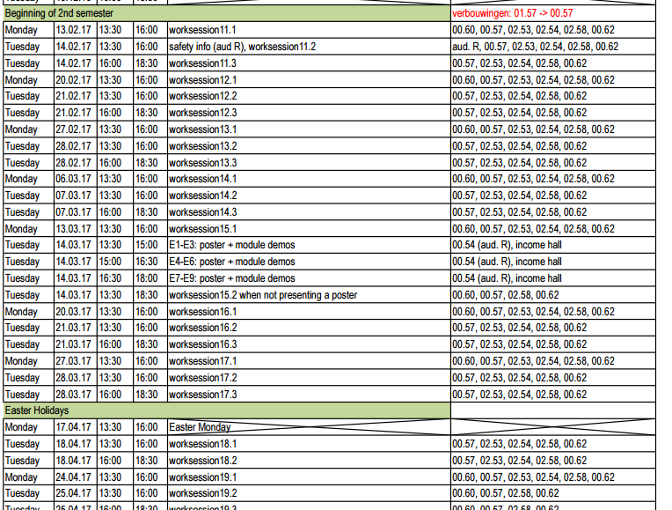
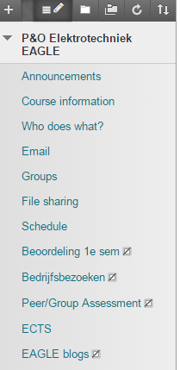
Schedule sem2 is now on Toledo

Slide 10
Typical week
Slots:
Monday 13:30-16:00, Tuesday 13:30-18:30
Rooms:
PC rooms: 3 or 4 from this list: 00.57, 00.60, 02.53, 02.54
02.58 (large room for prototyping, also PC room)
00.62 (drone room)
Who sits where?
Up to you… but make good arrangements
E.g. crypto (02.53), nav cntr (00.57), ESC/WPT (02.58)
Max 3 flying teams in the drone room. Don’t sit there if you do not need to fly
Know where to find your sub-teams and inform TA’s…

Slide 11
Overview
Planning 2nd semester
Room allocations
PC useage and ssh
Safety

Slide 12
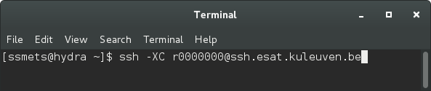
Can I work from my laptop?
Yes! You do not need an ESAT PC to run ESAT software
From Linux distributions:
ssh –XC rXXXXXXX@ssh.esat.kuleuven.be
ssh –XC vierre64
Now you can start working in this terminal

Slide 13
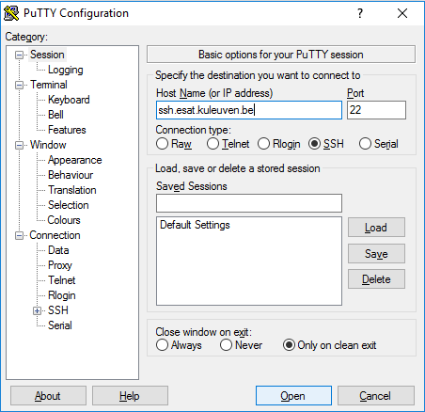
Can I work from my laptop?
Yes! You do not need an ESAT PC to run ESAT software
From Windows machines:
Install and open putty
Enter Host Name and Port
“Open”
Log in as: rXXXXXXX
Enter your ESAT password
Enter:
ssh –XC vierre64
Now you can start working in this terminal

Slide 14
Can I work from my laptop?
Yes! You do not need an ESAT PC to run ESAT software
From OSX:
ssh –YC rXXXXXXX@ssh.esat.kuleuven.be
ssh –XC vierre64
(Install Xquartz if required)
Now you can start working in this terminal

Slide 15
Overview
Planning 2nd semester
Room allocations
PC useage and ssh
Safety

Slide 16
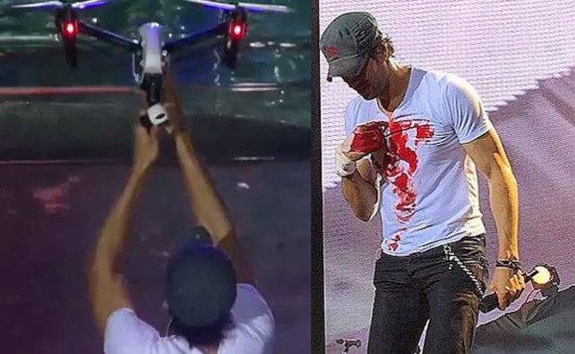
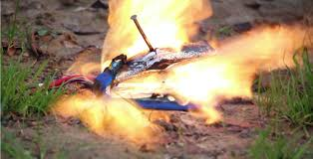
Eagle Safety!
Super super important ➔ Drones are MEGA fun, but they can cause serious injury if you are careless!!
2 main risks :
propeller cuts lipo battery fire
Enrique Iglesias grabbed drone during concert and cut his fingers
Lipo pierced with nail catches fire

Slide 17
Eagle Safety : propeller cuts
Safety measures
Kill switch: implemented in FPGA, cuts signal to motors
Arming procedure: implemented in flight software, disables throttle when unarmed and sends OFF signal to motors
Heartbeat: flight software sends control signal to FPGA each second to indicate it is operating. Prevents copter going wild by cutting signal to motors when software crashes.
Failsafe: implemented in receiver, activates kill switch when radio control connection is lost.
Throttle down = motors off and controller idle: must be implemented by students into flight controller software and demonstrated before flight

Slide 18
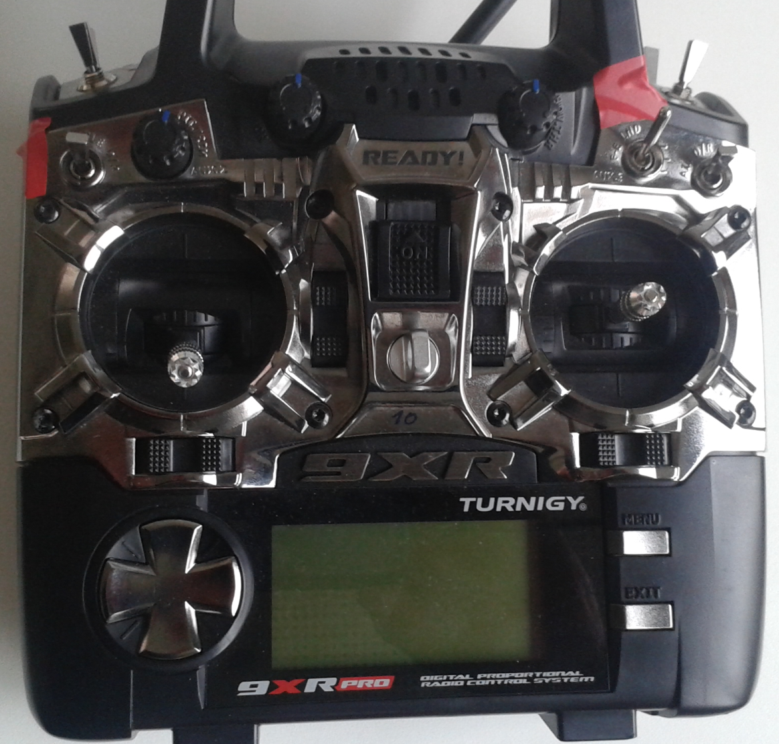
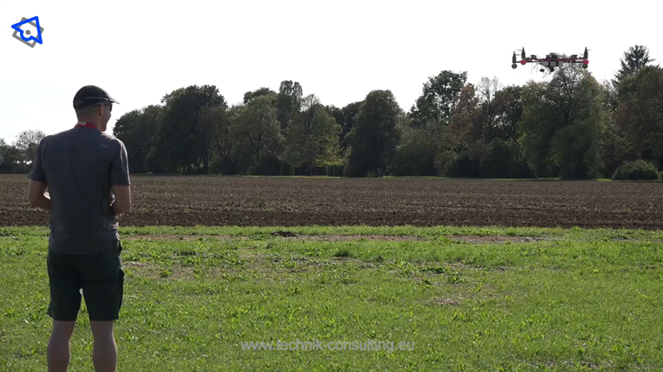
Eagle Safety : propeller cuts
RC transmitter : switches in forward (up) position = safe or manual state.
Holding throttle 2 sec downright = arm, downleft = disarm

Slide 19
Eagle Safety : propeller cuts
Never have an ARMED (activated) copter WITH propellers on OUTSIDE the safety net.
Only 1 person is allowed inside each compartment of the safetynet, together with the DISARMED copter, whose motors are killed with the killswitch.
When flying everyone, pilot included, is OUTSIDE the safetynet.
Never be alone when flying or testing with propellers on the motors.
Long hair should be tied and loose jewelry or scarfs avoided.
Flying is only allowed by students who have gotten instructions and are cleared for flight by Rudi Vanlaer.

Slide 20
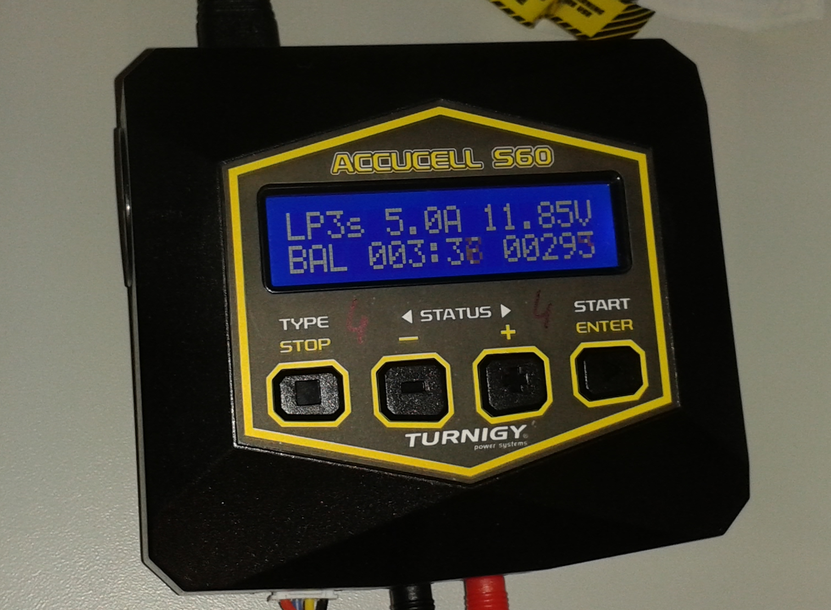
Eagle Safety : lipo fire
Lithium batteries can catch fire when they are badly mistreated, charged the wrong way, shorted or when polarity is reversed.
Only charge on dedicated charging stations and make sure charger settings are correct.
3S lipo
5,0A charge current
Voltage between 9,0V – 12,6V
Press ‘+’ to see voltages per cell
Between 3,0V and 4,20V
All should be equal within 0,05V

Slide 21
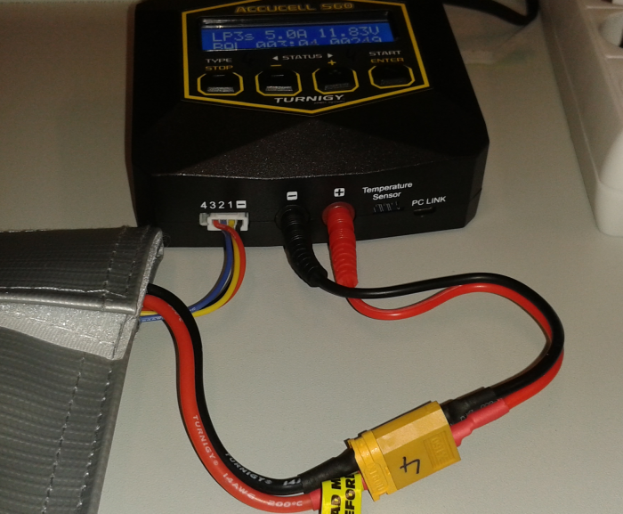
Eagle Safety : lipo fire
READ LIPO AND CHARGER INSTRUCTIONS
ALWAYS use safety bag and charge on non-flammable surface
Never charge unattended
Never overcharge lipos
Store in lipo bag and in cabinet
Don’t expose to temperature > 70°C
Never short circuit or reverse polarity
Always use balance charging function
Connect balance charge plug correctly!!
Do not remove or bypass fuse 50A–2sec

Slide 22
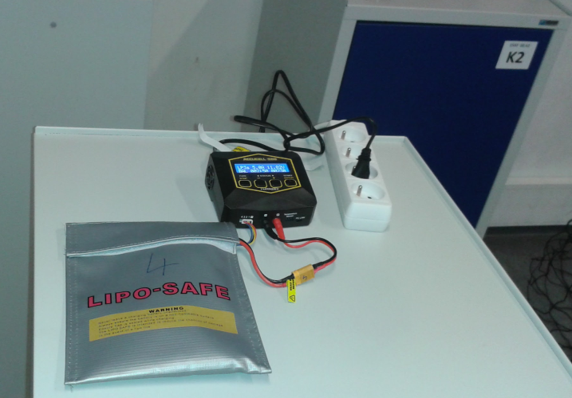

Eagle Safety : lipo fire
Correct way to charge lipo’s

Slide 23
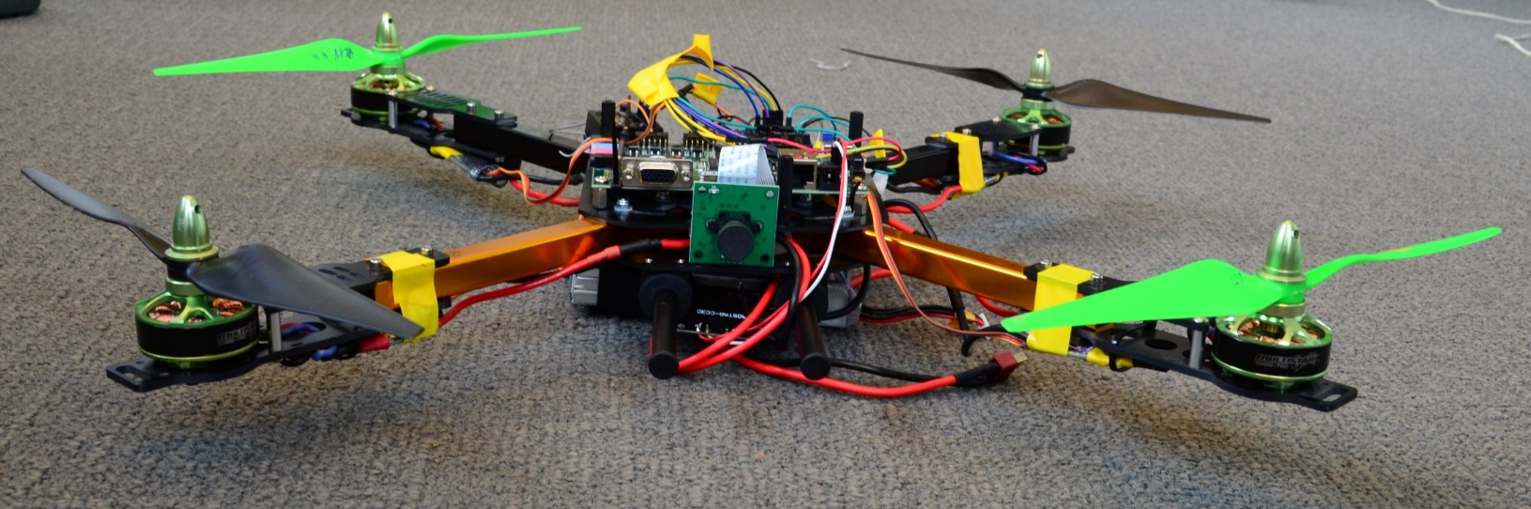
Overview
Planning 2nd semester
Room allocations
PC useage and VPN
Safety
Questions?
Enjoy!

